Slide 1
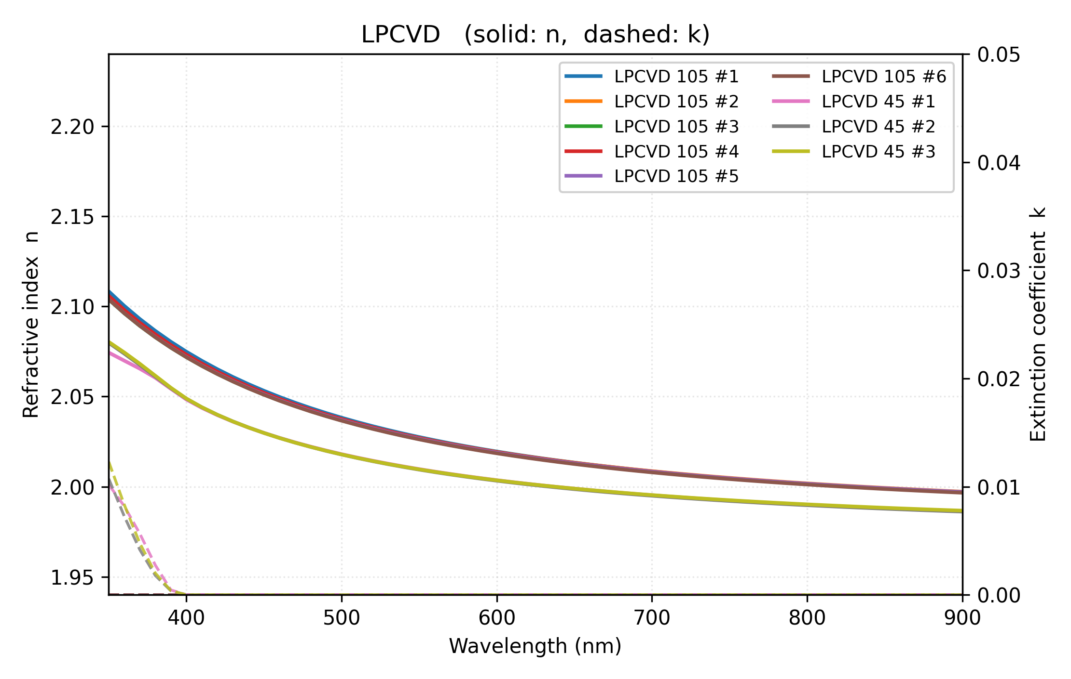
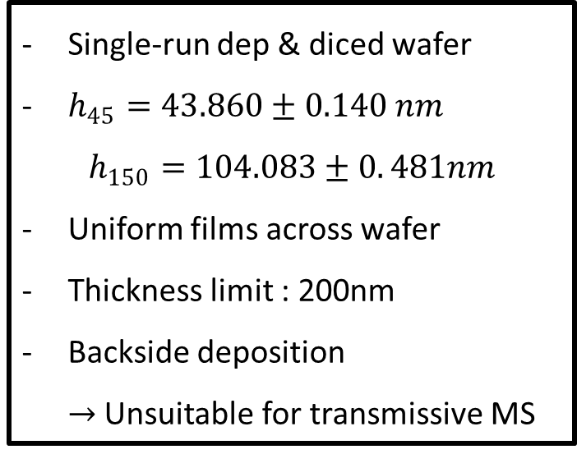
LPCVD (SNU)
Single-run dep & diced wafer
$h_{45}=43.860±0.140 nm$
$$h_{150}=104.083±0. 481nm$$
Uniform films across wafer
Thickness limit : 200nm
Backside deposition
$→$ Unsuitable for transmissive MS
H (nm) | Imaging (493nm) | Raman (532nm)
45 | 2.0193+i 0.0000 | 2.0123+i 0.0000
105 | 2.0390+i 0.0000 | 2.0302+i 0.0000

Slide 2
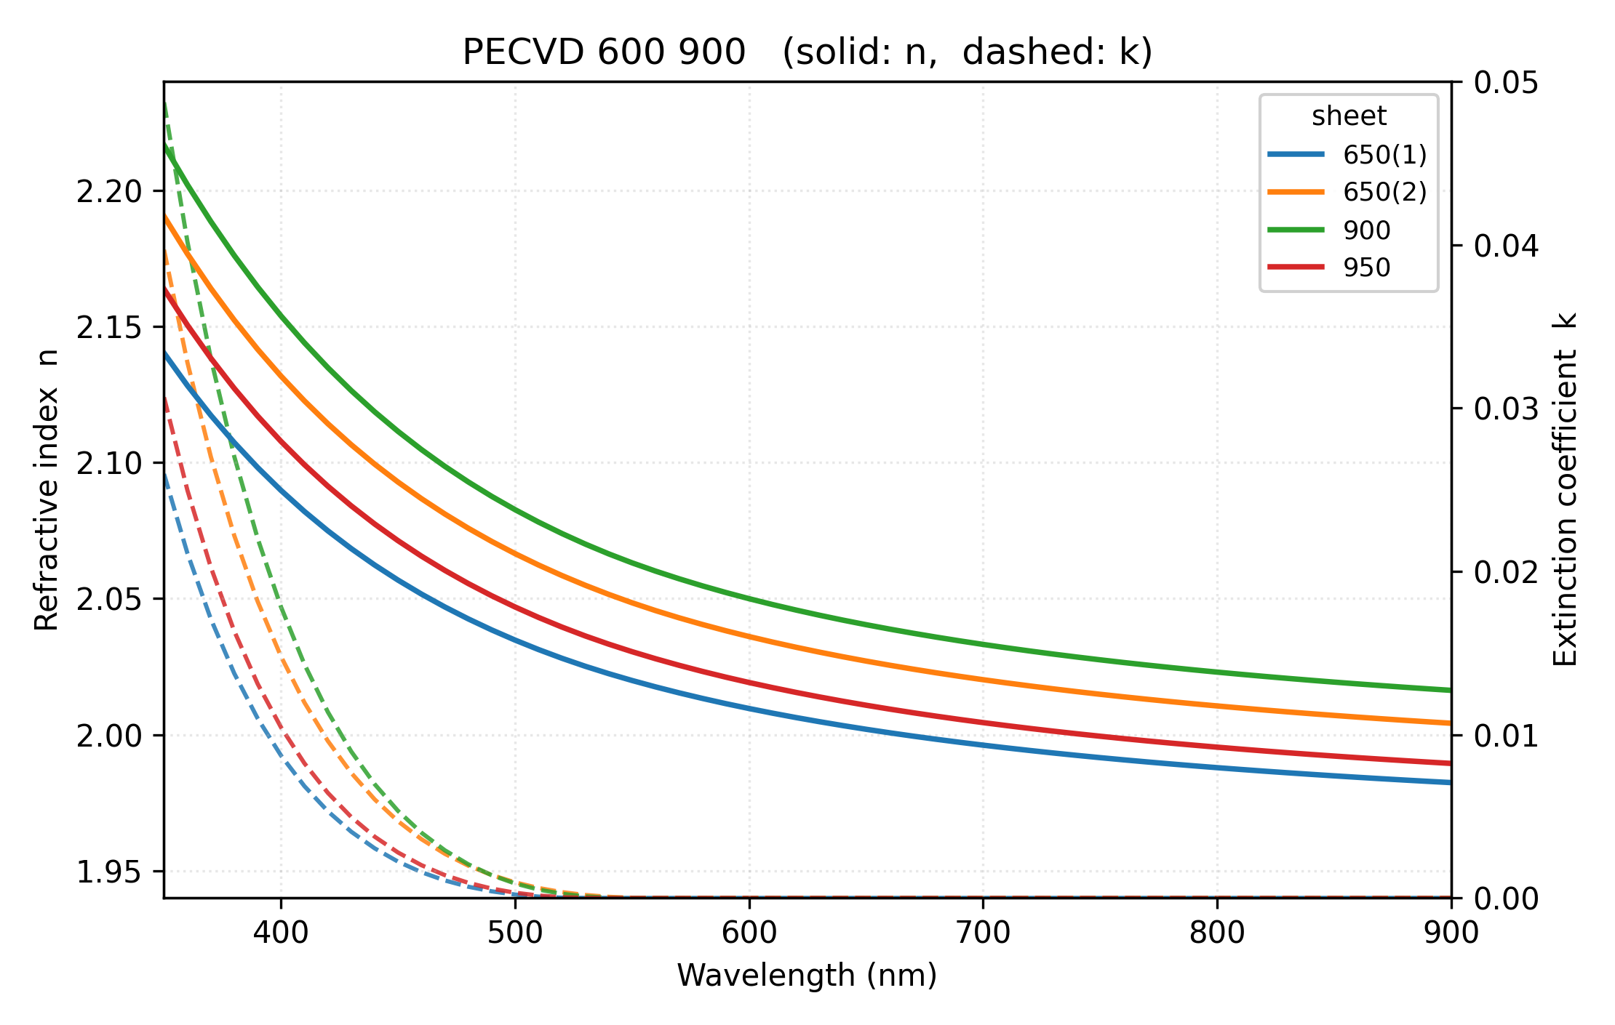
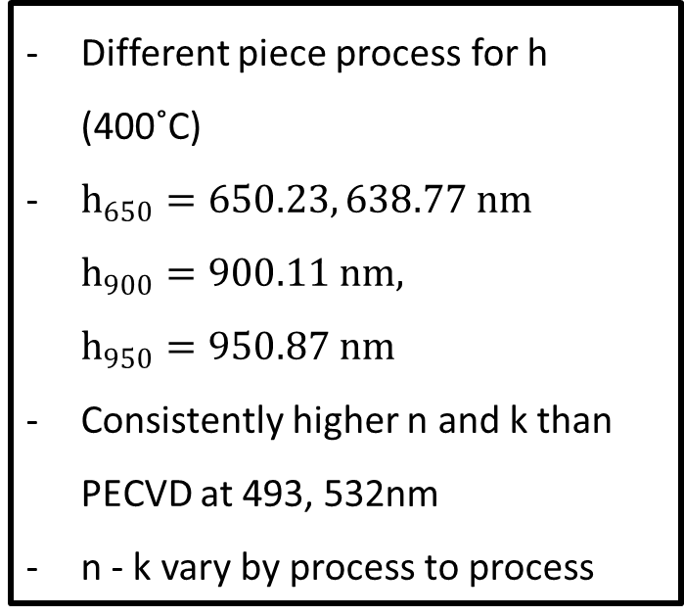
PECVD (KANC)
Different piece process for h (400˚C)
$h_{650}=650.23, 638.77 nm$
$h_{900}=900.11 nm,$
$h_{950}=950.87 nm$
Consistently higher n and k than PECVD at 493, 532nm
n - k vary by process to process
H (nm) | Imaging (493nm) | Raman (532nm)
650 | 2.0535+i 0.0008 | 2.0394+i 0.0001
900 | 2.0861+i 0.0012 | 2.0693+i 0.0001
950 | 2.0498+i 0.0005 | 2.0356+i 0.0000

Slide 3
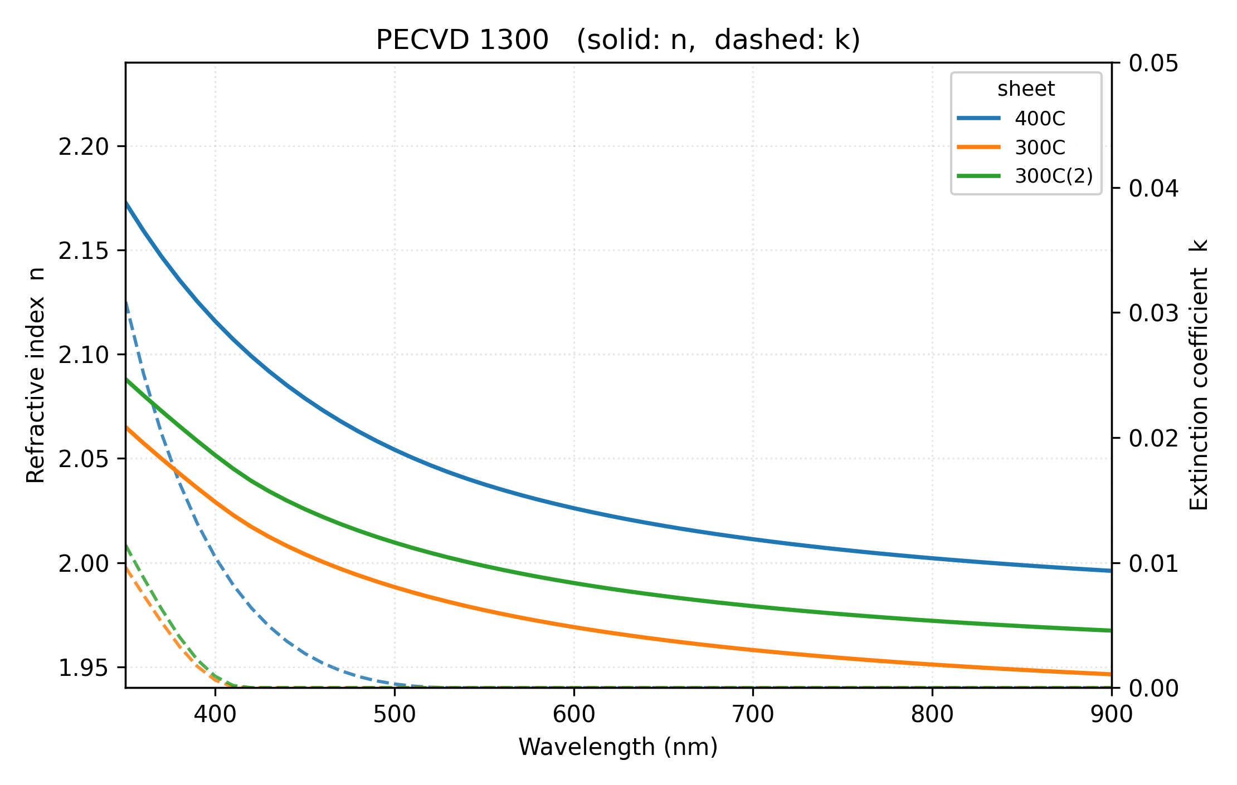
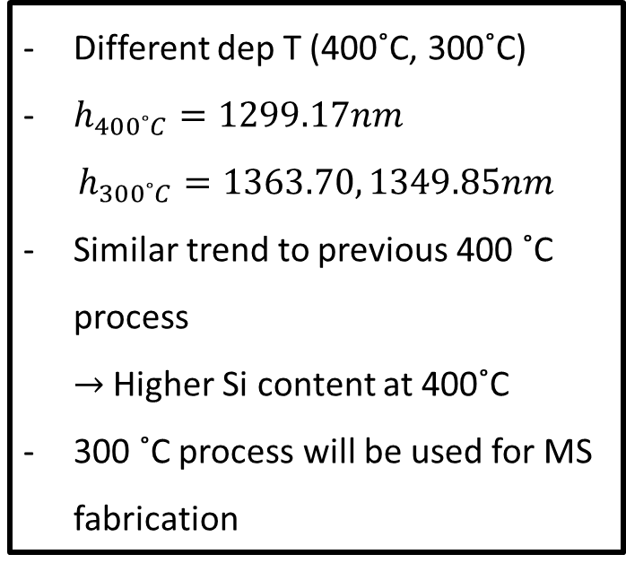
PECVD (KANC)
Different dep T (400˚C, 300˚C)
$h_{400˚C}=1299.17nm$
$h_{300˚C}=1363.70, 1349.85nm$
Similar trend to previous 400 ˚C process
$→$ Higher Si content at 400˚C
300 ˚C process will be used for MS fabrication
T (˚C) | Imaging (493nm) | Raman (532nm)
300 | 2.0008+i 0.0000 | 1.9914+i 0.0000
400 | 2.0571+i 0.0005 | 2.0428+i 0.0000

Slide 4
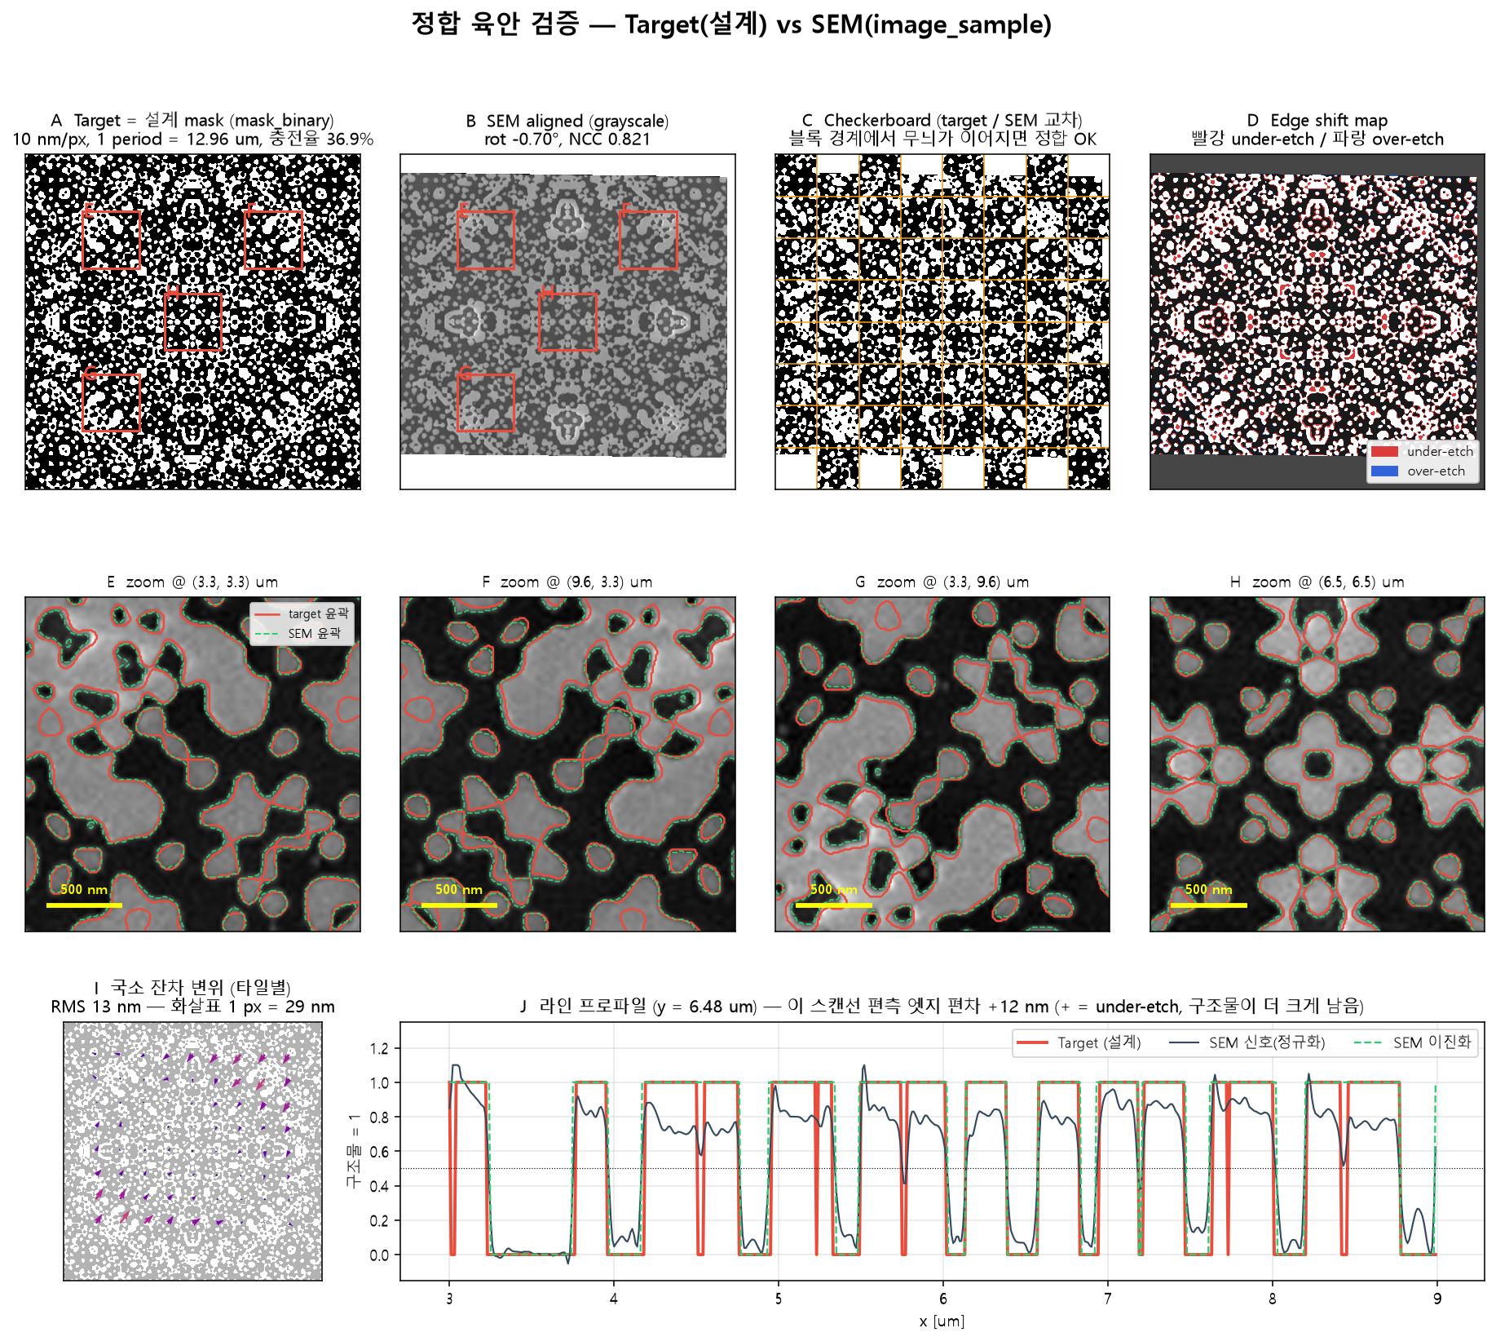
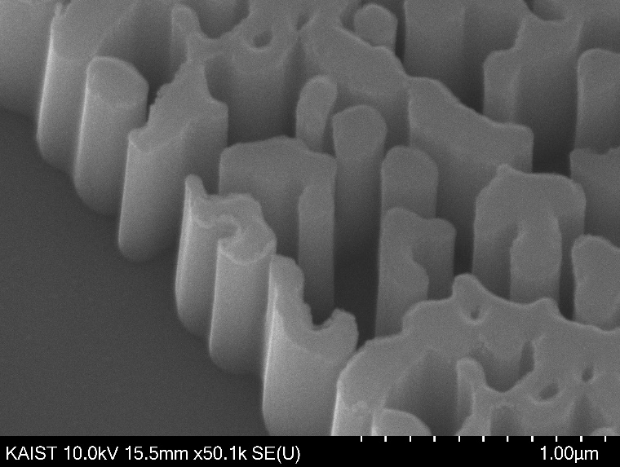

Fabrication window (Freeform MS)
500 nm
2 $μ$m
Minimum feature (80%) : 60 nm
Minimum pitch (80%) : 80 nm
Not a direct comparison due to SiN sidewall angle issue

Slide 5
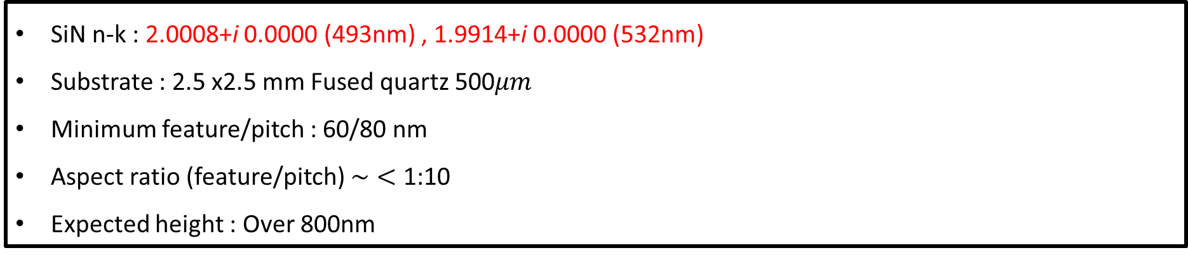
Summary
SiN n-k : 2.0008+i 0.0000 (493nm) , 1.9914+i 0.0000 (532nm)
Substrate : 2.5 x2.5 mm Fused quartz 500$μm$
Minimum feature/pitch : 60/80 nm
Aspect ratio (feature/pitch) $\sim <$ 1:10
Expected height : Over 800nm
Question
Has the target phase map or the required optical performance already been defined?
What does "tolerance" refer to in each of the requested data?

